Slide 1


Uncertainty-Aware Vision-and-Language Navigation for Agricultural UGV
From instruction understanding and spatial perception to reliable navigation decisions
Md. Symum Hossain, Jiyun Kim, Kyunghwan Choi
Cho Chun Shik Graduate School of Mobility, KAIST
_{29th September 2026}

Slide 2

Why Agricultural VLN?
A robot must
understand what the instruction means, determine what it sees, and decide how to move.
A2A was introduced specifically for agricultural VLN, with 1,560 episodes across six agricultural scene types and front-facing RGB observations from a quadruped robot.
Agricultural environments are different from clean indoor navigation.
Vegetation, occlusion, changing appearance, and ambiguous instructions make both perception and navigation harder.

Slide 3
Literature Review:
Paper | Main Problem | Key Method / Contribution | Reported Result | Gap Relevant to Our Proposed Work
AgriVLN | VLN had not been specifically developed/evaluated for agricultural environments; long instructions are difficult to track | Introduced A2A benchmark and AgriVLN VLM baseline; added Subtask List (STL) to decompose long instructions | On the reported A2A setup, STL improved SR 0.31 → 0.42 | Improves instruction/subtask tracking, but does not explicitly estimate whether the robot's perception or spatial information is reliable
MDE-AgriVLN | Monocular RGB provides limited explicit spatial/depth information | Adds a Monocular Depth Estimation (MDE) module to generate depth information from RGB for multimodal reasoning | SR 0.23 → 0.32, NE 4.43 m → 4.08 m on its reported A2A setup | Depth improves spatial perception, but RGB–depth alignment can itself be wrong, potentially misleading the decision-maker
SUM-AgriVLN | The robot loses useful spatial context between repeated tasks/instructions | Uses VGGT-based 3D reconstruction and stores 2D spatial memory for later navigation | SR 0.47 → 0.54, with NE 2.91 m → 2.93 m on A2A | Adds spatial memory, but the authors report limitations with static scenes and the information capacity of 2D memory
T-araVLN | Agricultural instructions contain noise, ambiguity, and mistakes | Uses an LLM-based instruction translator to convert noisy instructions into refined, precise instructions before navigation | With GPT-4.1 translator: SR 0.63, NE 2.28 m on A2A | Improves the language side of navigation, but does not explicitly model uncertainty in visual, depth, localization, or spatial information
ACME | Fixed multimodal fusion does not adapt well when information quality changes | Adaptive Cross-Modal Experts + Uncertainty-Driven Fusion (UDFM); confidence is used to dynamically weight coarse- and fine-grained predictions | On R2R validation-unseen, ACME reports 72.75% SR / 62.30% SPL; UDFM raises performance over the model without UDFM | Directly introduces uncertainty/confidence-aware fusion, but its uncertainty concerns coarse/fine action predictions rather than explicit semantic, depth, localization, and spatial-memory reliability for agricultural UGV navigation

Slide 4
Literature-Evolution
AgriVLN
Long instructions → Subtask List (STL)
AgriVLN's key issue was difficulty tracking which part of a long instruction was currently being executed; STL was introduced to decompose the instruction into subtasks.
MDE
RGB → Monocular depth → better spatial information
MDE-AgriVLN adds depth features estimated from RGB to improve spatial perception.

Slide 5
Literature-Evolution
SUM
Current observation + past spatial context
SUM adds spatial memory through 3D reconstruction and spatial representation.
T-ara VLN
Noisy language → refined language
T-ara introduces an LLM-based translator that refines noisy and mistaken instructions before VLM decision-making.
Existing work improves what the robot understands, sees, remembers, and receives.
But how does the robot know whether its current understanding is reliable enough to act?

Slide 6
Existing agricultural VLN methods progressively improve instruction understanding, depth perception, and spatial memory, while ACME demonstrates uncertainty-aware multimodal fusion. However, a unified agricultural UGV navigation framework that explicitly estimates the reliability of multiple semantic-spatial sources and uses that uncertainty to adapt waypoint selection and navigation behavior remains to be explored.

Slide 7
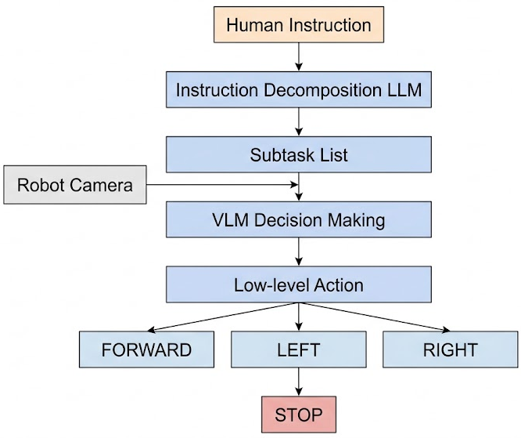
AgriVLN
Problem
Long instructions are difficult to track.
“Good morning, doggie. I am the farmer watering plants right now, and I need your help moving the blue spray bottle from my hand to the front of the sunflowers. To begin with, walk along the path to approach me and carry the blue spray bottle. Then you need right rotate to face the sunflowers ... oh sorry, left rotating is correct. Please keep going forward and stop when you reach the sunflowers.”
Height around 0.38 m
Sub Tasks:
Walk toward the farmer.
Turn left toward the sunflowers.
Move forward toward the sunflowers.
Stop when you reach the sunflowers.
Spatial understanding remains limited when RGB alone does not provide sufficient distance information.
Reported result
The paper reports SR improvement from 0.33 → 0.47 with STL on A2A.
Problem with number of Subtask>=4

Slide 8
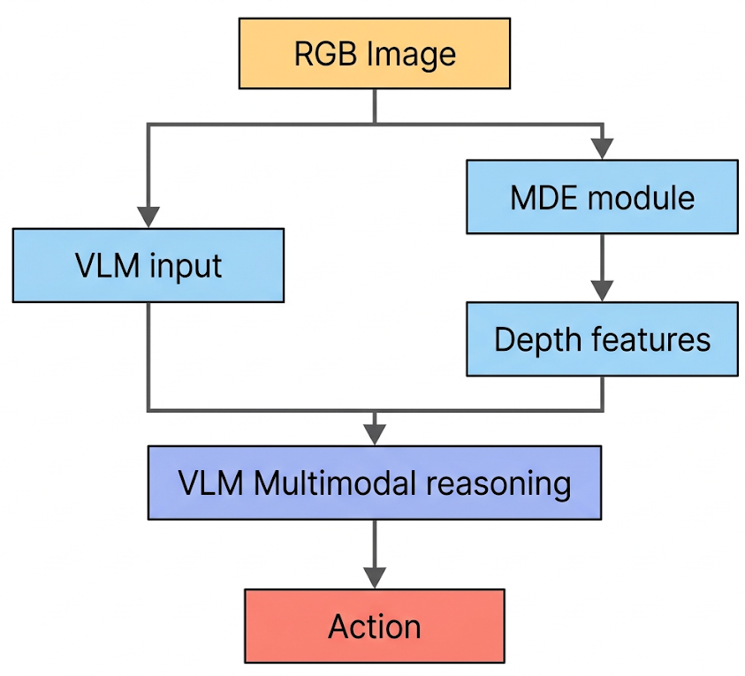
MDE-AgriVLN
Problem
RGB provides semantic information but limited explicit spatial information.
Generate depth from a single RGB image and provide it to the decision-maker
Reported result
The paper reports: SR:0.23→0.32 and NE:4.43m→4.08m
In its reported experimental configuration, MDE-AgriVLN improved SR from 0.23 to 0.32.
Remaining issue
The paper identifies issues including RGB-depth object misalignment and MDE processing cost; one qualitative failure shows incorrect association between an object and its dep
Depth sensors can be expensive for realistic agricultural deployment instead a single photographic image into a depth map is wise option.

Slide 9
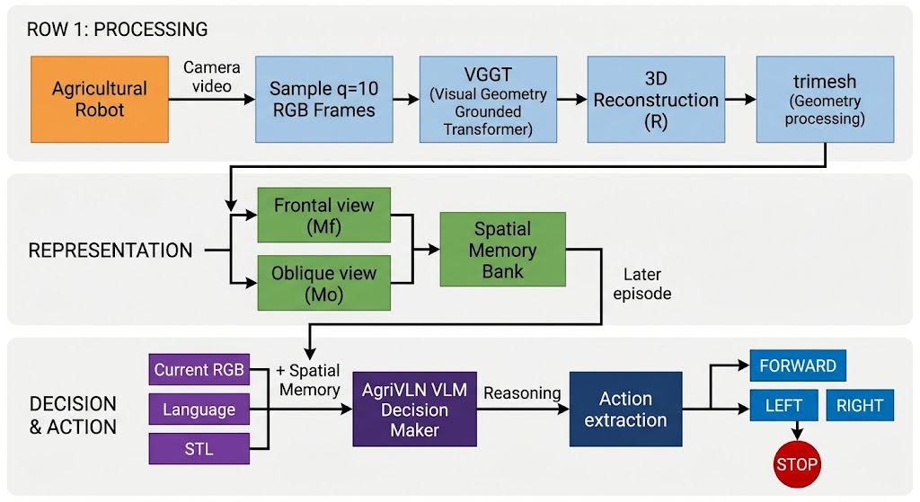
SUM-AgriVLN
Problem
AgriVLN treats instructions independently and does not exploit past spatial context.
Method
SUM uses spatial understanding and 3D reconstruction to create spatial memory.
Reported result
SR:0.47→0.54 and NE:2.91m→2.93m
Spatial memory provides past context, but the reliability of stored/current spatial information is not explicitly the main decision variable.

Slide 10
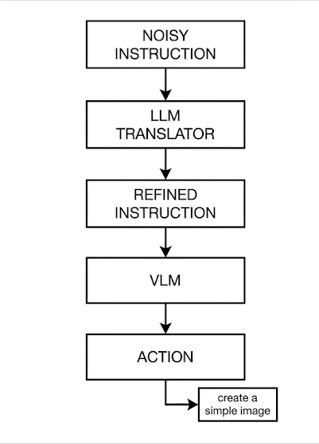
T-araVLN
The translator uses five principles:
IR → Inessential Removal (Remove words that do not help navigation)
ER → Errors Revision (asks the translator to recognize the correction)
HL → High-Low Separation(Agricultural instructions can contain a high-level purpose followed by low-level navigation commands)
RR → Representational Rotation(Keep left rotating until the green sprayer is in your horizontal center. )
RM → Representational Movement
Original:
“Stop when you are very close to her.”
Translated toward:
“Move forward until she occupies all your camera view.”
Remaining issues
The paper itself identifies:
translation does not use visual input,
translation costs about 0.8–2.5 s per instruction,
LLM/VLM access is API-based.
Reported result
With GPT-4.1 as translator:
SR=0.63 and NE=2.28m
on the whole A2A benchmark in the paper's comparison.
The goal is to replace vague language with more visually grounded conditions.

Slide 11
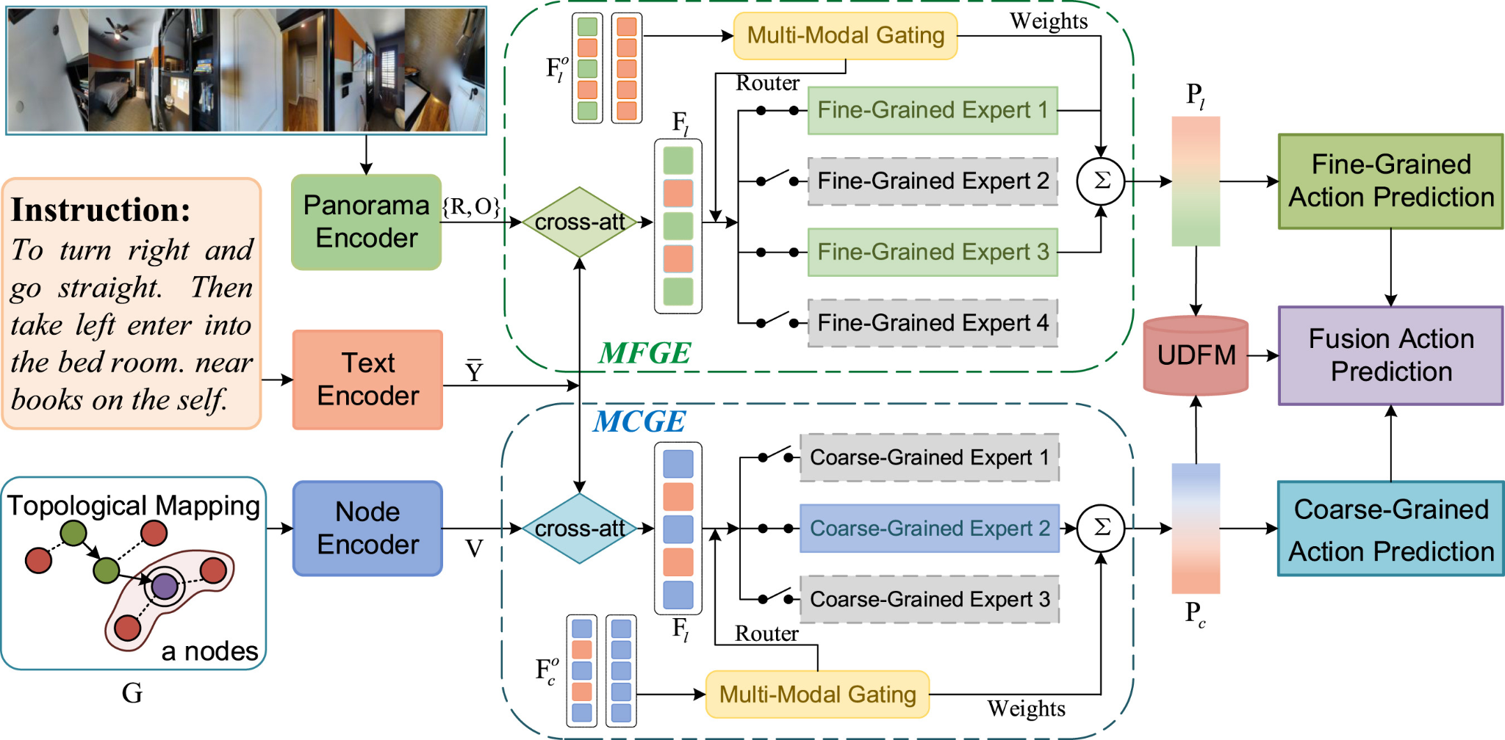
ACME — Uncertainty-Driven Fusion for VLN
Problem
Existing VLN systems may use fixed multimodal fusion, even when the quality/reliability of global and local information changes across situations. ACME addresses this by adapting the contribution of different expert predictions.
ACME = Adaptive Cross-Modal Experts Network + Uncertainty-Driven Fusion (UDFM)

Slide 12

Instead of always giving both branches a fixed weight, ACME estimates their confidence and dynamically changes their fusion weights:
ACME — Uncertainty-Driven Fusion for VLN
where Wc and Wf are obtained from the confidence-based UDFM.
ACME shows that uncertainty/confidence can be used to adapt how different information sources contribute to a navigation decision.
it estimates confidence and dynamically gives more weight to the more reliable information.
our proposed work extends this idea toward semantic + depth + localization + spatial-memory reliability, followed by uncertainty-aware waypoint selection and re-observation/re-planning.
On R2R validation-unseen, the full ACME model reports: SR=72.75%, SPL=62.30% for Ablation Study

Slide 13
Information to Reliable Decision-Making
AgriVLN: "What should I do?"
Instruction / Subtasks
MDE: "What is around me?"
Depth / Spatial information
SUM:"What have I seen before?"
Spatial Memory
T-ara:"How should I interpret
the instruction?"
Refined language
REMAINING QUESTION
Is the robot's current
semantic-spatial understanding reliable enough to act?
UNCERTAINTY ESTIMATION
UNCERTAINTY-ADAPTIVE NAVIGATION
A recent work on uncertainty VLN:Uncertainty aware VLN (ACME)

Slide 14
Natural Language Instruction
Instruction Translator
Subtask List (STL)
RGB
Depth
Robot State/Localization
Synchronized Observations
Multi-modal perception
Semantic & Geometric Information
Semantic
Depth
Localization
Spatial memory
Current
semantic-geometric--spatial state X(t)

Slide 15
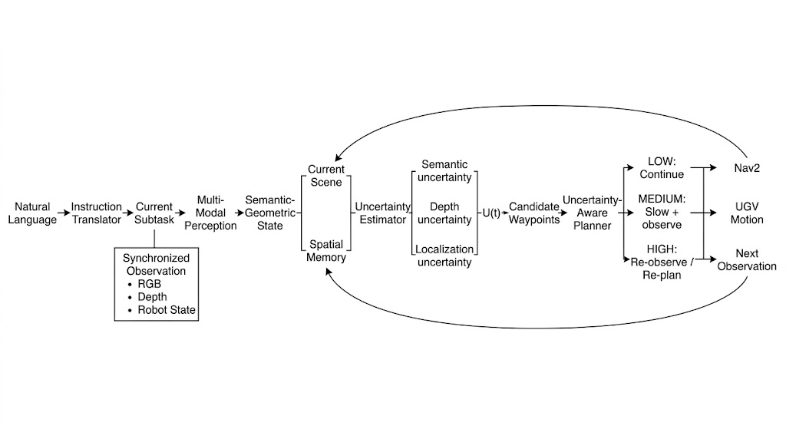



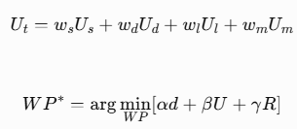
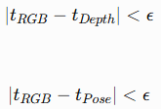
Proposed Dataflow
Instruction:
Go along the crop row → turn at tree → stop at greenhouse
uncertainty the robot is seering
uncertainty in the estimating depth
uncertainty in the robot’s own position
Current subtask: "Turn at tree"
Go close to the tree and then turn left... no, actually right
UGV
Motion
Next
Observation
Move along the crop row and turn left near the tree
RGB: "Tree detected"
Depth: "Tree approximately
4.2 m away"
Robot state:
"x = 5.1 m, y = 2.3 m"
Synchronized
Turn right when the tree is centered in the camera view.
As an extension

Slide 16
Proposed Dataflow
Instruction:
Go along the crop row → turn at tree → stop at greenhouse
uncertainty the robot is seering
uncertainty in the estimating depth
uncertainty in the robot’s own position
Current subtask: "Turn at tree"
Go close to the tree and then turn left... no, actually right
UGV
Motion
Next
Observation
Move along the crop row and turn left near the tree
RGB: "Tree detected"
Depth: "Tree approximately
4.2 m away"
Robot state:
"x = 5.1 m, y = 2.3 m"
Synchronized
Turn right when the tree is centered in the camera view.
As an extension

Slide 17


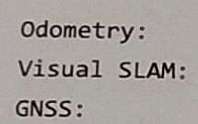









Uncertainty Estimation & Adaptive Weight Fusion
< Threshold
[8, 9, & 10]
semantic
depth(multiple models)
Current and memorized situation
Spatial case
localization
Cross source agreement/Disagreement
Dynamic Gating
= Fused Weight
common state representations for generating waypoints

Slide 18
Conclusion & Proposed Direction
The robot may have more information, but more information does not guarantee reliable information.
Estimate uncertainty in semantic, depth, localization, and spatial-memory information, then adapt waypoint selection and observation behavior accordingly.

Slide 19
Progress Update
Baseline setup and a pilot study on our own videos
25 October 2026
1
Baseline setup
2
Pilot study
3
What it means
AgriVLN running on our workstation; what A2A can and cannot test
2 phone videos in A2A format, 4 runs with a local VLM
Failure analysis, link to our uncertainty design, next steps
Notes:
This section reports what was done since the last meeting: getting the AgriVLN baseline running, what we learned about the A2A benchmark from its code, and a small pilot study on two videos we recorded ourselves.

Slide 20
Baseline Setup: AgriVLN Running on Our Workstation
Instruction
Subtask List
Decision every 0.2 s
Scoring
natural-language task
(info.json)
LLM splits the task
(STL.py)
VLM picks FORWARD / LEFT /
RIGHT / STOP (decide.py)
SR, NE against labels
(evaluate.py)
Hardware constraint shaped the model choice
Status
GPU: RTX 5060 with 8 GB VRAM (Ubuntu 24.04)
Released code: DeepSeek-R1-32B + Qwen2.5-VL-32B, about 20 GB each; does not fit
Paper's SR 0.47 / NE 2.91 m: GPT-4.1 + GPT-4.1-mini via API
Now: qwen2.5vl:7b locally via Ollama (free), so results are a pipeline test, not comparable to the paper
Ready: adapters to switch to GPT or Claude with one import line
Done
Environment: conda, Python 3.11
Done
AgriVLN + local VLM running on GPU
Done
Video-to-A2A episode converter
Waiting
A2A data: not public; author emailed
Waiting
API key (full baseline ≈ $20–50, estimate)
Notes:
AgriVLN runs as a four-stage loop: the instruction is split into subtasks by an LLM, then a VLM picks one action every 0.2 seconds, and the run is scored against hand labels. Our GPU has 8 GB, so the released 32B models do not fit. For now I use the free qwen2.5vl 7B model locally; the numbers are therefore a pipeline test, not a reproduction. I wrote small adapters so that the same code can call GPT-4.1 or Claude once we have an API key. Setup issues along the way (conda, Ollama service, wrong folders) are all solved. The main blocker is that the A2A dataset is not publicly hosted; I emailed the first author.

Slide 21
A2A Cannot Test Localization Uncertainty
Found in evaluate.py: navigation error comes from timing, not from robot positions
Public datasets to validate each uncertainty term
How A2A computes NE
Dataset | Sensors / setting | Validates
CitrusFarm (2023) | Tree rows; RGB-D, LiDAR, IMU, wheel odometry, GNSS-RTK | U_{d}, U_{l}, U_{s} (start here)
Rosario v1 / v2 | Soybean field; stereo, IMU, GNSS-RTK; v2 adds GNSS dropouts | U_{l}
BLT (Bacchus) | Same vineyard rows, March to September | U_{m}
BotanicGarden | Dense vegetation, GNSS-denied, semantic labels | U_{s}, U_{l}
Sugar Beets 2016 | Field robot, multispectral + depth, crop/weed labels | U_{s}
The predicted stop time is compared with the labelled stop time and converted to metres using the path length (assumed walking speed 1.3 m/s).
Example from our video 2 (run 3)
18 m × (1 − 3.8 s / 16.0 s) ≈ 13.7 m
A2A is RGB video only: no depth sensor, no robot pose.
So U_{l} (localization) cannot be evaluated on A2A; it needs pose ground truth or our own UGV.
None of these contain language instructions: they validate the uncertainty terms, A2A validates navigation.
Notes:
Reading the evaluation code showed that A2A's navigation error is not measured from positions. It is the gap between when the agent stops and when the label says to stop, converted to metres. Together with RGB-only data, this means localization uncertainty cannot be tested on A2A. The table lists public agricultural datasets with real ground truth that can validate each uncertainty term separately; CitrusFarm is the best first choice.

Slide 22
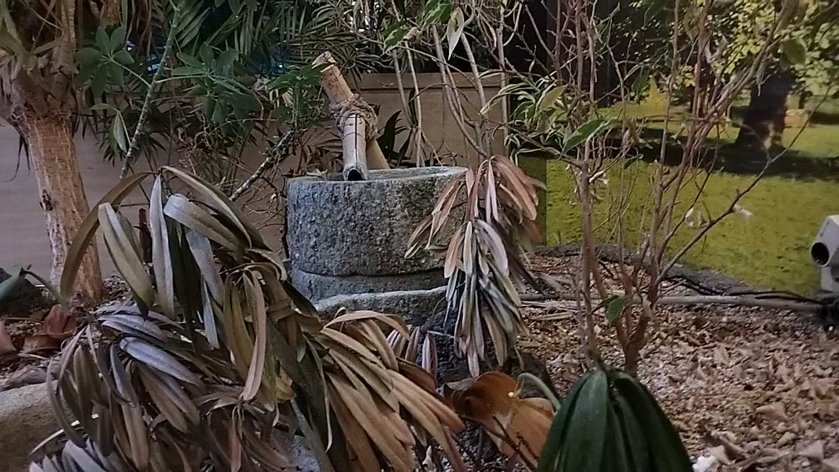
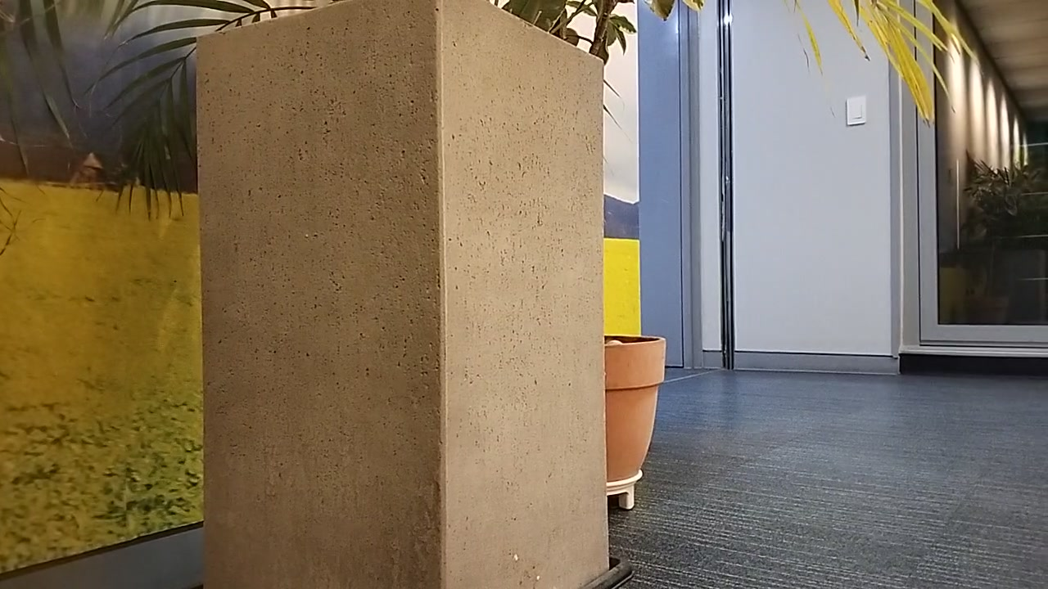
Pilot Study: Our Own Videos in A2A Format
While waiting for A2A data, we built two episodes ourselves and ran AgriVLN on them
1
Record
2
Convert
3
Label
4
Run
Phone, landscape, held low (~0.4 m); 17–18 s walk; stand still for the last 2 s
make_episode.py: frames at 5 FPS with A2A file names, info.json
Hand-labelled actions: FORWARD until the target, then STOP
AgriVLN with qwen2.5vl:7b for both subtasks and decisions
Video 1 target: round stone basin with a bamboo spout · label stop 15.0 s · 17 m
Video 2 target: tall rectangular concrete planter · label stop 16.0 s · 18 m
Notes:
Because the A2A data is not available yet, I recorded two short walks with a phone held low, close to the robot dog's 0.38 m camera, converted them into exactly the A2A episode format, and labelled the actions by hand. The two targets are shown here: a round stone basin and a tall concrete planter. The location is an indoor planted atrium, not a farm, so this is a pilot, not a benchmark.

Slide 23
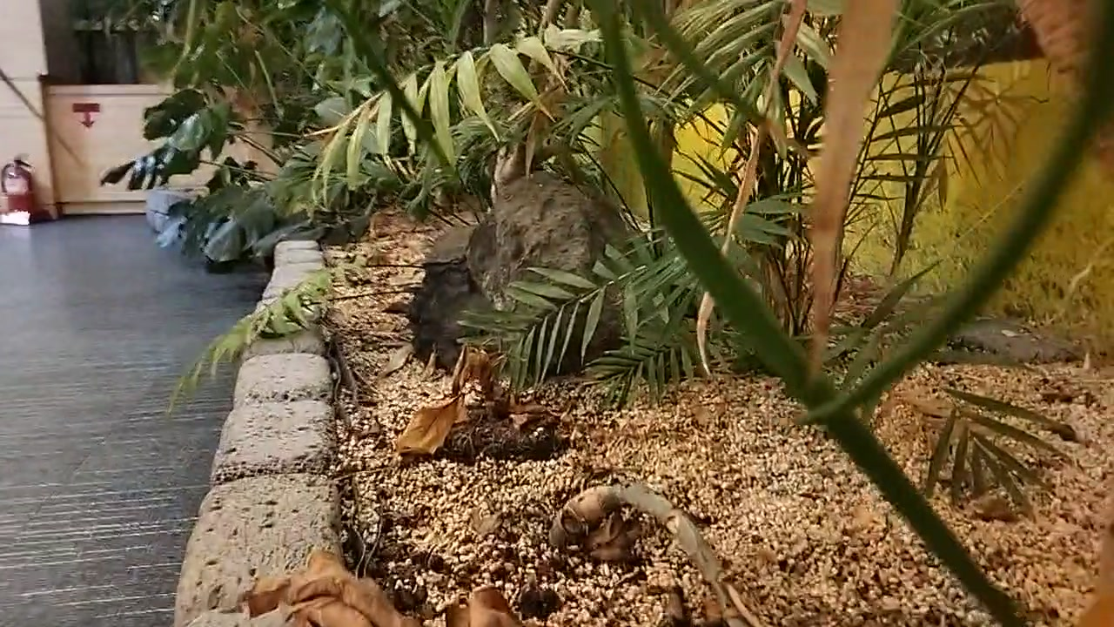
Video 1: The Agent Stopped at a Boulder, 13 s Early
Agent stopped here · 1.8 s
Real target · about 16 s
A dark boulder and grey stone curb blocks: no basin, no spout
Round stone basin with a bamboo spout
1.8 s
14.7 m
0
2 / 3
first STOP (label: 15.0 s)
navigation error
success rate
subtasks self-reported done
Instruction named the basin correctly and the subtask list was sensible; the agent walked forward correctly for 1.6 s, then stopped.
Notes:
In video 1 the subtask list was good and named the basin correctly. The agent walked forward correctly for 1.6 seconds and then stopped at 1.8 seconds, in front of a boulder and stone curb blocks, 13 seconds before the real target. It took something stone-like, close, and in the centre of the view for the round basin with a spout. Its subtask bookkeeping was also out of order: it started the final stop subtask while still on the approach subtask.

Slide 24
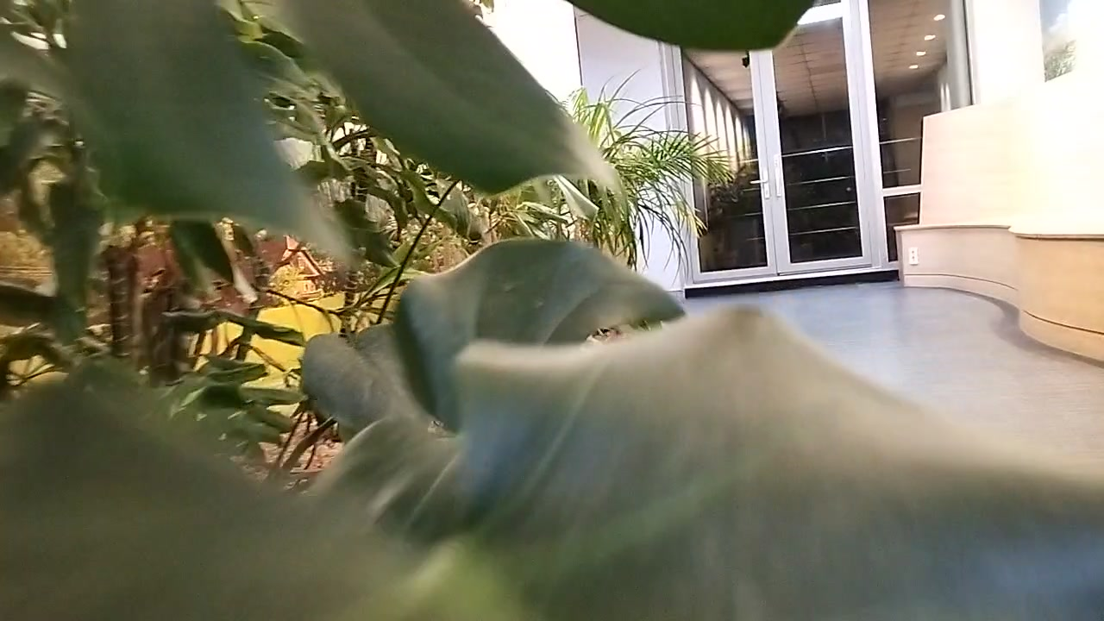
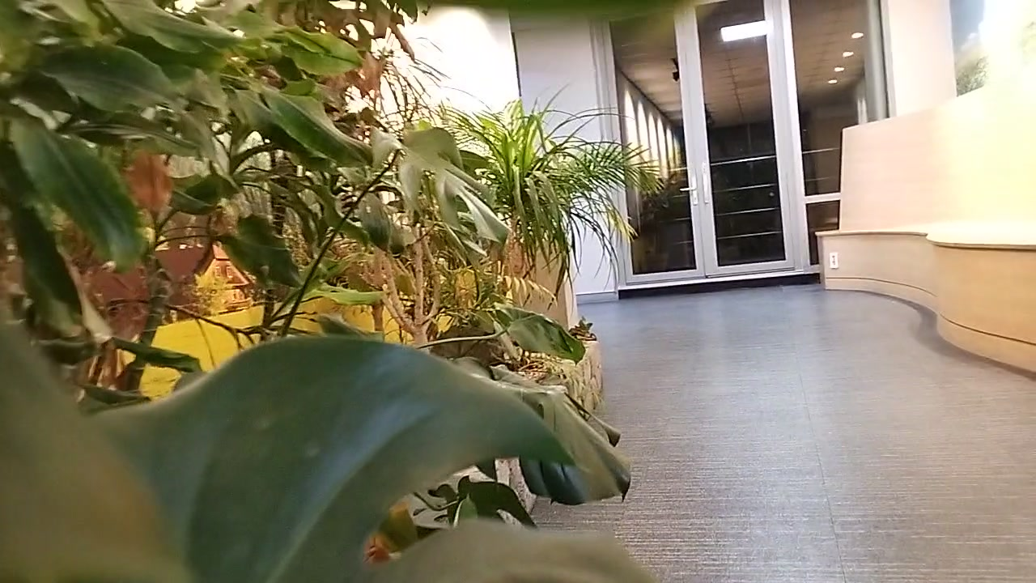
Video 2: Better Instructions Moved the Mistake
Run | Instruction (same video, label stop 16.0 s) | First STOP | NE | Ending
1 | Go straight along the path and stop when you reach the concrete block. | 0.4 s | 18.0 m | deviation
2 | … until the concrete block fills the lower part of the camera view, then stop. | 3.2 s | 14.4 m | valid stop
3 | … stop when the tall rectangular concrete planter fills the left half of the view, top to bottom. | 3.8 s | 13.7 m | valid stop
Success rate 0 in all three runs. Each rewrite moved the stop to whatever matched the described layout.
Run 2 stop · 3.2 s
Run 3 stop · 3.8 s
Real target · 16 s
Blurry leaf brushing the lens fills the lower view
Foliage fills the left half; planter not in view
Tall concrete planter beside the corridor
Notes:
Video 2 was run three times with the same labels and different instructions. The vague instruction failed immediately: 'reach' became 'block visible'. Adding a visual stop condition, the T-araVLN idea, delayed the stop from 0.4 to 3.2 seconds, and an accurate description of the planter to 3.8 seconds, but every run still stopped about 12 seconds early. The images show why: the agent stopped at whatever matched the described layout, first a blurry leaf filling the lower view, then foliage filling the left half, while the planter was not even visible. Our run-2 condition was itself wrong because it was written without seeing the target, which mirrors T-araVLN's own limitation: translation without visual input.

Slide 25
The Log Showed Confusion Before the Wrong Stop
Video 2, run 3: subtask states written by the agent at every 0.2 s step (log.json)
0.0 s
1.0 s
2.0 s
3.0 s
4.0 s
Subtask 1 · move along corridor
Subtask 2 · approach planter
Subtask 3 · stop at planter
Action
pending
doing
done
went backwards (doing → pending)
FORWARD
STOP
10 switches
STOP at 3.8 s
Zero-cost signal
between pending and doing in the first 3.6 s; 4 of them went backwards
chosen while the planter was not even in view (previous slide)
counting these switches is a first estimate of U_{s}: block STOP when it is high
Notes:
Besides the action, the agent writes the state of each subtask at every step. Before the wrong stop, subtask 1 and 2 kept switching between pending and doing: 10 switches in 3.6 seconds, 4 of them backwards, meaning the agent changed its mind about where it was in the task. Then it stopped while the target was not in view. These switches are free to compute from the log, so they are a natural first, zero-cost estimate of semantic uncertainty: if they are high, the robot should not stop but keep moving and look again.

Slide 26
Two Failures, Two Different Uncertainty Sources
 | Video 1 (stone basin) | Video 2 (concrete planter)
Mistook for the target | Boulder and stone curb blocks | Leaf brushing the lens; foliage
Underlying cause | Wrong object identity (stone-like, close, centred) | Occlusion and blur; target not in view
Would depth alone catch it? | No: the boulder really is close | Yes: object is centimetres away
Signal that would catch it | U_{s} semantic: "is this a round basin with a spout?" | U_{d} / image quality, plus U_{s}
No single source catches every failure. This supports our design: several uncertainty sources plus a fusion step that weighs them and detects cross-source conflict (A_{ij}), as on slide 17.
Caveats: small 7B local model · two short videos · indoor planted atrium, not a farm · hand-made labels · NE from an assumed speed of 1.3 m/s. A demonstration of the problem, not a benchmark result.
Notes:
Both videos show the same behaviour, a premature and confident stop on a look-alike, but the causes differ. In video 1 the boulder really is close, so a depth check would agree with stopping; only meaning, wrong shape and no spout, reveals the error. In video 2 the object is a leaf centimetres from the lens and the target is not visible, so depth and image quality expose it. No single uncertainty source catches both, which is the argument for multi-source estimation with conflict detection. Caveat: small model, two videos, indoor scene; this demonstrates the problem, it is not a result.

Slide 27
Next Steps
1
Short term
2
Medium term
3
Long term
Get A2A data (author contacted)
Reproduce AgriVLN baseline: local 7B model, then API model (target SR 0.47 / NE 2.91 m)
First U_{s}: subtask-switch count + repeated sampling (3–5 calls per step)
Check if high U_{s} comes before wrong actions (AUROC)
Confidence gate: block STOP when U_{s} is high
Record more easy (clear) and hard (occluded) videos
U_{d}: monocular depth (Depth Anything V2, UniDepthV2) on CitrusFarm vs LiDAR
U_{l}: CitrusFarm / Rosario v2 vs RTK ground truth
Fusion with cross-source agreement
Ablations: single vs all sources; fixed vs reliability vs learned weights; with / without A_{ij}; hand-set vs conformal thresholds
U_{m}: memory staleness on BLT (March to September)
Closed-loop UGV tests with Nav2: show that re-observing improves navigation
Timeline estimate (approximate): full project about 500–800 h, i.e. 10–16 months at ~12 h/week for one person; offline-only version about 5–7 months; faster if split across three authors.
Notes:
Short term, the priority is the A2A data and a proper baseline, then the first semantic-uncertainty measure built from the agent's own log plus repeated sampling, and a simple gate that blocks STOP when uncertainty is high. Medium term, depth and localization uncertainty on CitrusFarm and Rosario, then fusion and ablations. Long term, memory uncertainty and closed-loop tests on the UGV, which are needed to show that re-observing actually improves navigation.

Slide 28
References
[1] P. Anderson et al., “Vision-and-Language Navigation: Interpreting Visually-Grounded Navigation Instructions in Real Environments,” CVPR, 2018.
[2] X. Zhao, X. Lyu, and X. Li, “AgriVLN: Vision-and-Language Navigation for Agricultural Robots,” arXiv:2508.07406, 2025.
[3] X. Zhao, X. Lyu, and X. Li, “MDE-AgriVLN: Agricultural Vision-and-Language Navigation with Monocular Depth Estimation,” arXiv:2512.03958, 2025.
[4] X. Zhao, X. Lyu, X. Chen, and X. Li, “SUM-AgriVLN: Spatial Understanding Memory for Agricultural Vision-and-Language Navigation,” arXiv:2510.14357, 2025.
[5] X. Zhao, X. Lyu, X. Chen, and X. Li, “T-araVLN: Translator for Agricultural Robotic Agents on Vision-and-Language Navigation,” ICIC 2026, LNCS, 2026.
[6] J. Wu, C. Wu, X. Shen, and L. Wang, “Adaptive Cross-Modal Experts Network with Uncertainty-Driven Fusion for Vision–Language Navigation,” Knowledge-Based Systems, vol. 307, 112735, 2025.
[7] X. Zhao, X. Lyu, X. Chen, and X. Li, “TEA-AgriVLN: Traversability Estimation Alarm for Agricultural Vision-and-Language Navigation,” arXiv:2607.28474, 2026.
[8] Y. Han, K. Zhang, X. Wang, Z. Pan, Z. Liu, and J. He, “Trust, but Verify: Uncertainty-Driven Evidential Multimodal Representation Learning,” IJCAI 2026, pp. 1143–1151, 2026.
[9] Y. Lou et al., “Uncertainty-Encoded Multi-Modal Fusion for Robust Object Detection in Autonomous Driving,” ECAI 2023, 2023.
[10] H. Wang et al., “Active Perception for Visual-Language Navigation,” International Journal of Computer Vision, vol. 131, pp. 607–625, 2023.

Slide 29
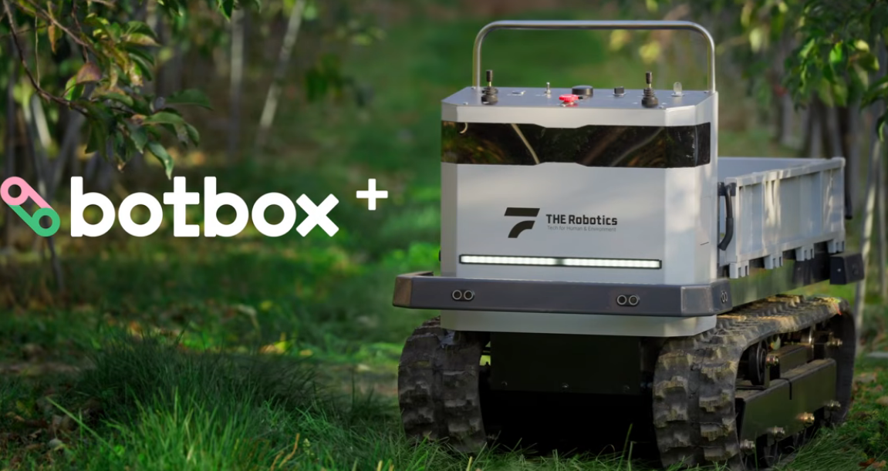
Problem / Motivation
Introduction
Agri field has unstructured and dynamic environments
Complex navigation conditions
Lighting, weather, and appearance can change significantly
Obstacles may be difficult to distinguish from surrounding vegetation.
An agricultural robot needs to jointly understand:
What the user says + What the robot sees + Where & How the robot should go
Autonomous Agricultural UGV with VLM-based Scene Understanding and Multi-sensor Fusion as Worker Assistance
BOTBOX: https://www.youtube.com/watch?v=tJYAQmHQ4eY&t=1s

Slide 30
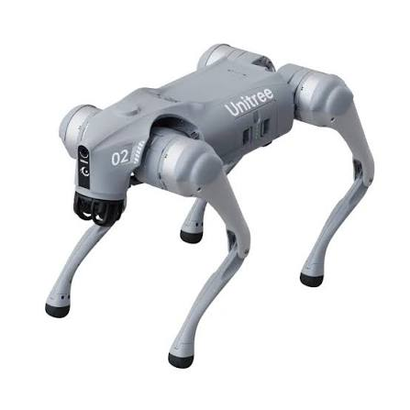
AgriVLN: Vision-and-Language Navigation for Agricultural Robots (Introduction)
Related Works
The authors introduce:
Agriculture to Agriculture (A2A)
This is their benchmark specifically designed for agricultural robot VLN.
The benchmark contains:
1,560 episodes
6 agricultural scene classifications
RGB video(Resolution: 1280 × 720, approximately 14 FPS and approximately 1100 kbps bitrate)
front-facing camera
camera height around 0.38 m above from the ground(more realistic)
a quadruped robot-Unitree Go2 Air
natural-language instructions
Scene Classes(episodes)
Farm: 372
Greenhouse: 258
Forest: 384
Mountain: 198
Garden: 258
Village: 90
X. Wang et al., "AgriVLN: Vision-and-Language Navigation for Agricultural Robots," arXiv preprint arXiv:2508.07406, 2025. Presented at ICONIP 2026.

Slide 31
AgriVLN: Vision-and-Language Navigation for Agricultural Robots (Pipeline)
Related Works
Intentionally makes instructions more casual and noisy rather than perfectly clean
Realistic human speech, but difficult for an AI model.
“Good morning, doggie. I am the farmer watering plants right now, and I need your help moving the blue spray bottle from my hand to the front of the sunflowers. To begin with, walk along the path to approach me and carry the blue spray bottle. Then you need right rotate to face the sunflowers ... oh sorry, left rotating is correct. Please keep going forward and stop when you reach the sunflowers.”
They claimed: The central problem: long instructions may cause long horizon navigation issues
Their solution: Subtask List (STL)
Task: “Go to the farmer, turn left, face the sunflowers, move forward, and stop."
Sub Tasks:
Walk toward the farmer.
Turn left toward the sunflowers.
Move forward toward the sunflowers.
Stop when you reach the sunflowers.
Particle Principle
Synonymity Principle
Connection Principle
GPT-4.1 mini for this role.
zero-shot model.
A2A's average trajectory length is reported as 7.1 m
X. Wang et al., "AgriVLN: Vision-and-Language Navigation for Agricultural Robots," arXiv preprint arXiv:2508.07406, 2025. Presented at ICONIP 2026.
Notes:
"Turn left and walk toward the greenhouse."
Bad decomposition:
"Turn left."
because it loses:
walk toward greenhouse.
Another bad decomposition:
"Turn left and run toward the large greenhouse."
"Turn left and walk toward the greenhouse."
Bad decomposition:
"Turn left."
because it loses:
walk toward greenhouse.
Another bad decomposition:
"Turn left and run toward the large greenhouse."
In plain English:
The condition that finishes Step 1 should make sense as the condition that starts Step 2.
Example:
Step 1
Walk toward farmer.
End:
Farmer is visible and approached.
Step 2
Turn toward sunflowers.
Start:
Farmer is visible and approached.
Perfect connection.

Slide 32
AgriVLN: Vision-and-Language Navigation for Agricultural Robots (Results)
Related Works
Scene | Instruction length | SR | NE
Farm | 40.9 | 0.66 | 1.79
Greenhouse | 42.1 | 0.35 | 2.56
Forest | 48.0 | 0.33 | 3.68
Mountain | 40.9 | 0.50 | 2.84
Garden | 53.3 | 0.49 | 3.77
Village | 55.9 | 0.47 | 2.92
Method | SR ↑ | NE ↓
Random | 0.09 | 7.03
GPT-4.1 mini | 0.33 | 2.76
SIA-VLN | 0.31 | 3.24
DILLM-VLN | 0.36 | 2.60
AgriVLN | 0.47 | 2.91
Human | 0.87 | 0.57
VLM | With STL SR | NE | Without STL SR
Gemini-1.5 Flash | 0.24 | 3.51 | 0.20
Llama-4 Maverick | 0.33 | 4.22 | 0.38
GPT-4.1 mini | 0.47 | 2.91 | 0.33
Table 1.3: Ablation Study
Table 1.2: Baseline Comparison
Table 1.1: Scene Study
Table 1.5: Without STL
Table 1.4 With STL
Subtasks | SR
2 | 0.58
3 | 0.38
≥4 | 0.14
Subtasks | SR
2 | 0.51
3 | 0.15
≥4 | 0.00
X. Wang et al., "AgriVLN: Vision-and-Language Navigation for Agricultural Robots," arXiv preprint arXiv:2508.07406, 2025. Presented at ICONIP 2026.

Slide 33
AgriVLN: Vision-and-Language Navigation for Agricultural Robots (Research Gap)
Related Works
Long/complex instructions
Performs well on short instructions but drops for long instructions because it loses track of which part of the instruction it is executing.
Ambiguous instructions (Acknowledged in T-araVLN)-0.47 to 0.63
Referential ambiguity, conflicting ambiguity
Poor spatial-distance understanding (Acknowledged in MDE Agri-VLN and SUM Agri-VLN)
Scene-dependent robustness
Background clutter, obstacle density, and lighting conditions
Large gap from humans
Overall SR is 0.47 compared with human SR 0.87
Real-world deployment missing
X. Wang et al., "AgriVLN: Vision-and-Language Navigation for Agricultural Robots," arXiv preprint arXiv:2508.07406, 2025. Presented at ICONIP 2026.

Slide 34
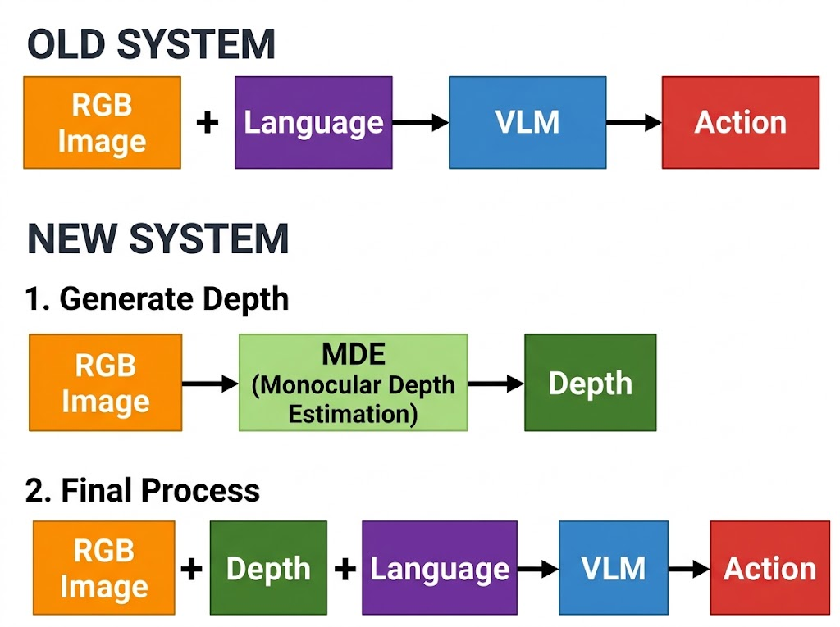
MDE-AgriVLN: Agricultural Vision-and-Language Navigation with Monocular Depth Estimation
Related Works
Knowing how far away they are
The authors claimed,
The paper reports that this improves the A2A benchmark's overall:
SR: 0.23→0.32 SR
and
NE: 4.43m→4.08m.
but still,
human SR: 0.87 and NE: 0.57
The paper uses: Qwen2.5-VL-32B as its VLM
Every pixel/location can have an associated depth value.(Depth Map)
Depth sensors can be expensive for realistic agricultural deployment instead a single photographic image into a depth map is wise option.
Agri-VLN:
MDE-Agri-VLN:
 | Farm | Forest
With MDE | SR:0.60 | SR: 0.13
without MDE | SR: 0.47 | SR: 0.06
Depth estimator | Depth type | SR | NE | TUp | TUc
Depth Anything V2 | Metric | 0.30 | 4.23 | 2,287 | 222
Pixel-Perfect Depth | Relative | 0.34 | 4.19 | 1,626 | 212
Depth Pro | Metric | 0.32 | 4.08 | 2,205 | 198
Representation | SR | NE
Depth Matrix | 0.32 | 4.08 m
Depth Map | 0.32 | 4.24 m
Hybrid | 0.31 | 4.31 m
X. Zhao et al., "MDE-AgriVLN: Agricultural Vision-and-Language Navigation with Monocular Depth Estimation," arXiv preprint arXiv:2512.03958, 2025.

Slide 35
SUM-AgriVLN: Spatial Understanding Memory for Agricultural Vision-and-Language Navigation
Related Works
Past spatial experience is not being used in VLN. Global information is needed. A collection of frames + 3D reconstruction can help derive the second.
SUM-AgriVLN lets the robot build a spatial memory of an agricultural environment from a previous episode and recall that memory during a later episode.
understanding geometric relationships from multiple images
Use multiple 2D images to recover information about the 3D structure of the environment.
principle is uniform temporal sampling of images. (trade-off)
trimesh is used to manipulate and render 3D geometric objects/meshes.
Frontal View (0 to 5 degree)
Oblique View(40 to 50 degree)
to override hidden behind objects.
Camera height: 0.38 meter
3D-RGB
X. Zhao et al., "SUM-AgriVLN: Spatial Understanding Memory for Agricultural Vision-and-Language Navigation," arXiv preprint arXiv:2510.14357, 2025.
Notes:
understanding geometric relationships from multiple images

Slide 36
SUM-AgriVLN: Spatial Understanding Memory for Agricultural Vision-and-Language Navigation
Related Works
Past spatial experience is not being used in VLN. Global information is needed. A collection of frames + 3D reconstruction can help derive the second.
SUM-AgriVLN lets the robot build a spatial memory of an agricultural environment from a previous episode and recall that memory during a later episode.
understanding geometric relationships from multiple images
Use multiple 2D images to recover information about the 3D structure of the environment.
principle is uniform temporal sampling of images. (trade-off)
trimesh is used to manipulate and render 3D geometric objects/meshes.
Frontal View (0 to 5 degree)
Oblique View(40 to 50 degree)
to override hidden behind objects.
Camera height: 0.38 meter
3D-RGB
X. Zhao et al., "SUM-AgriVLN: Spatial Understanding Memory for Agricultural Vision-and-Language Navigation," arXiv preprint arXiv:2510.14357, 2025.
Notes:
understanding geometric relationships from multiple images

Slide 37
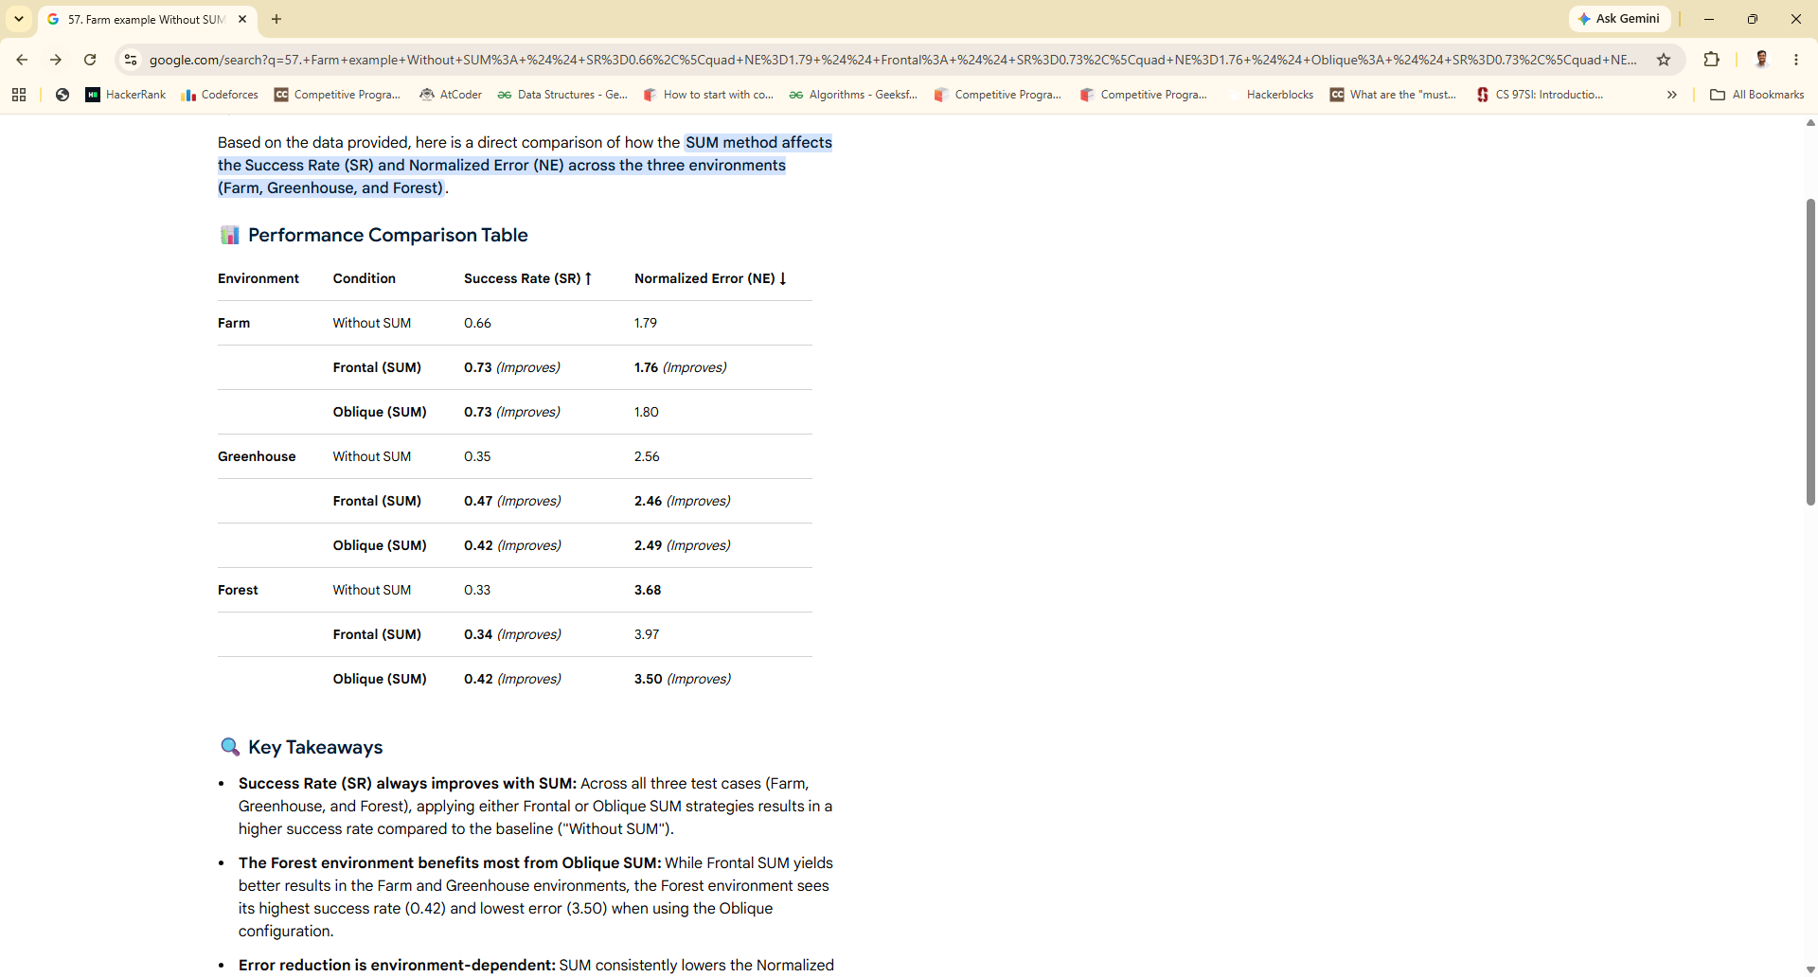
SUM-AgriVLN: Spatial Understanding Memory for Agricultural Vision-and-Language Navigation (Results)
Related Works
7% increase SR. 2% decrease NE
Warning: More information is not always better. (assumes static scenes )
Oblique is better than hybrid
Adding another perspective increases extra input tokens by approximately 18%
Subtasks | With SUM SR | With SUM NE | Without SUM SR | Without SUM NE
2 | 0.66 | 2.26 | 0.58 | 2.32
3 | 0.45 | 3.06 | 0.38 | 3.04
≥4 | 0.14 | 8.26 | 0.14 | 7.53
low-complexity
(subtask = 2),
high-complexity
(subtask ≥ 3)
Method | Low- complexity SR | Low NE | High- complexity SR | High NE | Whole SR | Whole NE
Random | 0.13 | 7.30 | 0.04 | 6.74 | 0.09 | 7.03
Fixed | 0.00 | 0.00 | 0.06 | 6.32 | 0.03 | 3.06
SIA-VLN | 0.52 | 1.46 | 0.08 | 5.12 | 0.31 | 3.24
DILLM-VLN | 0.41 | 1.36 | 0.32 | 3.90 | 0.36 | 2.60
AgriVLN | 0.58 | 2.32 | 0.35 | 3.54 | 0.47 | 2.91
SUM-AgriVLN | 0.66 | 2.26 | 0.42 | 3.64 | 0.54 | 2.93
Human | 0.93 | 0.32 | 0.80 | 0.82 | 0.87 | 0.57
X. Zhao et al., "SUM-AgriVLN: Spatial Understanding Memory for Agricultural Vision-and-Language Navigation," arXiv preprint arXiv:2510.14357, 2025.

Slide 38
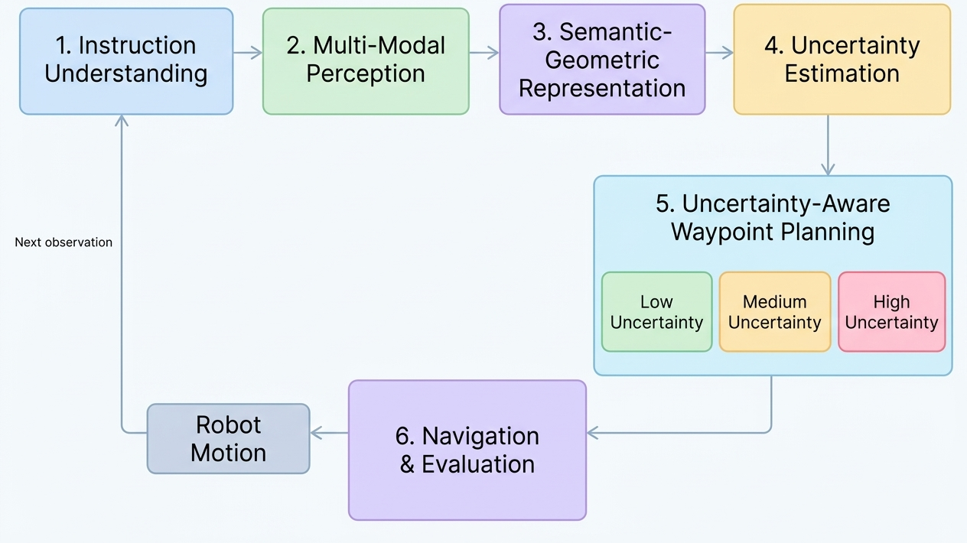
Uncertainty Aware Agriculture Navigation Planning (Proposed Methodology)
Related Works
Existing methods improve what the robot understands, how it perceives space, and what it remembers —
but they do not explicitly answer:
“How confident should the robot be about its current understanding, and what should it do when it is uncertain?”
Based on Uncertainty Level decision may be taken either follow optimal, or slow down, or recovery procedure for waypoint generation.

Slide 39
Thank you for your attention!
Recommendations are highly appreciated.
Notes:
“From these three papers, we can see a clear evolution. AgriVLN mainly addresses the language and instruction-following problem. MDE-AgriVLN improves the robot's spatial perception by adding depth information. SUM-AgriVLN further gives the robot spatial memory from previous observations. However, these improvements mainly provide the robot with more information. They do not explicitly model how reliable that information is. Therefore, my research direction is to investigate uncertainty-aware agricultural navigation: when the robot is confident, it can continue normally; when uncertainty becomes high, it should adapt its behavior, for example by slowing down, observing again, selecting a safer waypoint, or changing its route.”

